Slide 1
Friday
November 18th

Slide 2
BELL SCHEDULE
Period 1 | 8:45 am - 9:58 am
FLEX | 10:03 am - 10:34 am
Period 2 | 10:39 am - 11:52 am
LUNCH | 11:52 am - 12:32 pm
Period 4 | 12:37 pm - 1:50 pm
Period 5 | 1:55 pm - 3:08 pm

Slide 3
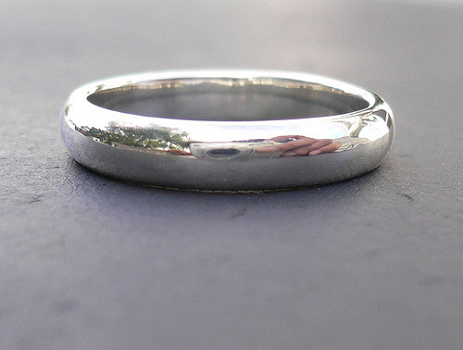
Girl’s Ring - FOUND
If you have lost your ring please come to the main office to claim. Be prepared to give a description.

Slide 4
University of Calgary
. . . is here Friday, November 18th at LUNCH in the Library Computer Lab.

Slide 5
SFU will be here next . . . Thursday, November 24th!!
SFU will be here next Thursday, November 24th at FLEX and LUNCH in the Library Computer Lab.

Slide 6
Scholarship Meeting
DATES: Tuesday November 22^{nd.}
Place: Library
Time: 3:15 pm -4:00 pm
Please mark your calendar
Bring your questions

Slide 7
Grade 12’s Important information here!
Your Grad Transition Package( the yellow one) is due Dec 15. You can hand this in to the Grad transition office at the end of the Grand Hall. Those people who get their packages in by that date will be entered into a draw for two grad dinner dance tickets.
If you have any questions see Mrs Nunn or Mrs Gay.

Slide 8
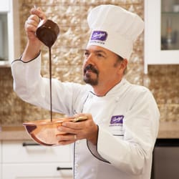
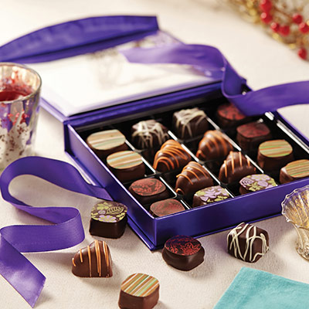
HWSS Grad Council Purdy’s Fundraiser
Go to https://www.purdysgpp.com/join/35257 to place your order today!
After you’ve logged in or registered for an account, you can use the Shop Online tab to buy some amazing chocolates or invite other members to join and support our fundraiser.
*Deadline Date for orders is Thursday December 1st*

Slide 9
KODIAK
ATHLETICS

Slide 10
Wheelchair Basketball
Intramural tournament
Wheelchair basketball intramural tournament sign up starts on Wednesday November 16 and goes until November 25
Sign up with a team
of 5 friends
Tournament starts Monday November 28th and goes until December 9th

Slide 11
KODIAK
CLUBS

Slide 12
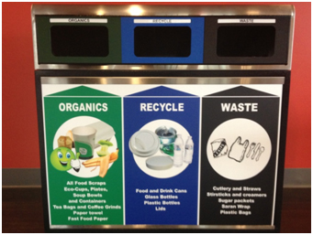
HWSS OUTDOOR CLUB Get outside and get involved!!
Meeting at FLEX today, Room 309
* We will be discussing the waste management initiative, and talking about more potential trips!

Slide 13
Want some volunteer hours? Join the Me to We movement and make the world a better place by being sociably responsible! Come by room 207 on Friday’s @ lunch. Get inspired through:
Music Style Travelling Reading
Music Style Travel Reading

Slide 14
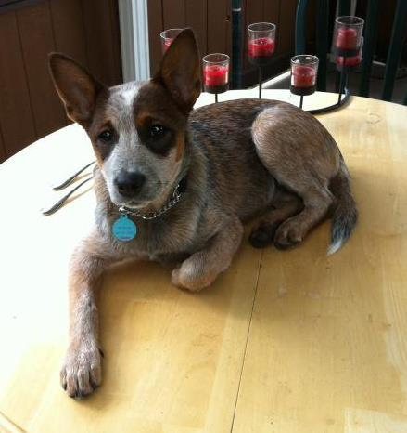
Just Paws
Love animals? Need a break from the stress of school? – You’re in luck!
Heritage Woods is gaining some furry friends that would love to help you calm down and relieve some stress! If your interested in dog walking or doggy cuddles come to the counselling area at FLEX on Fridays or contact Drew Gilchrist at gilchristdrew@gmail.com!
Schedule TBA, the more interest, the more often dogs will be in school!
Relax, don’t worry, “just pause”!
Let’s Cuddle….. Skylar!

Slide 15
Ski and Snowboard Club
Sign-up in Room 314 with Mr. Moretti.
Whistler Trip space is becoming limited…
Dec. 10 – 3 spaces left
Jan. 7 – 2nd bus added – 8 spots left
Jan. 28 – 2 spaces left (2nd bus may be added)
Mar. 4 – 10 spaces left

Slide 16
Attention Ski/Snowboard Club Members
Want to shred at Apex Mountain?
Dates: Feb. 24-26
Sign up forms available in Room 314
20 spaces remaining
See Mr. Moretti for details

Slide 17
REPEAT
NOTICES

Slide 18
ATTN All HWSS Students
Please check the lists posted outside room 300 to verify the spelling of your name in the yearbook. If there’s an error, please contact yearbook at:
hwssyearbook@gmail.com

Slide 19
HWSS Baseball hats for sale in main office
$20.00

Slide 20
Interested in purchasing a Kodiaks lanyard?! ➔ $5 at the office ⬅

